Slide 1

TITLE- Electroencephalogram Brain Signal Processing for Chromatic Visual Impression Identification.
(differentiate the brain signals from red and white colour)
Supervisor Name:
Prof. Debasis Samanta, CSE, IIT Kharagpur
: Tutan Nama, PHD scholar, CSE,IIT Kharagpur
:Subrata Pain, PHD scholar, CSE,IIT Kharagpur

Slide 2
Contents
1. Project Description
2. Plan of when and for how much duration to show red or white color:
3. Step by step process we used OpenBCI to collect the brain signals data.
3.1 Setting the hardware part
3.2 Setting the software part
4. Data description
5. Data Pre-processing
6. Data epoching
7. Feature extraction
8. Feature Selection
9. Models used
10. Results of Each Model on different features Combination
11. conclusion

Slide 3
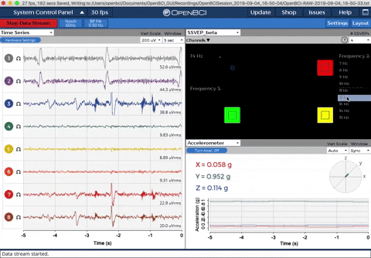
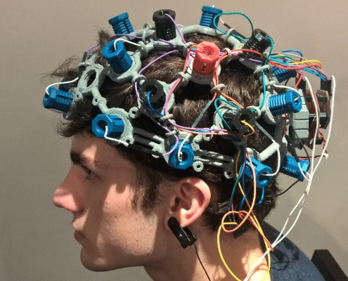
1. Project Description
TITLE- Electroencephalogram Brain Signal Processing for Chromatic Visual Impression Identification.
(differentiate the brain signals from red and white colour)
Description- we are using openBCI device to record the signals from the brain, when the subject is shown only red and white colors. And then using Preprocessing steps, extracting features and training models to differentiate between 2 colors(white or red).
Applications- if we are able to discriminate two different colors then we can use this as two control commands for controlling any dedicated computer applications.
(especially helpful for handicapped people)

Slide 4
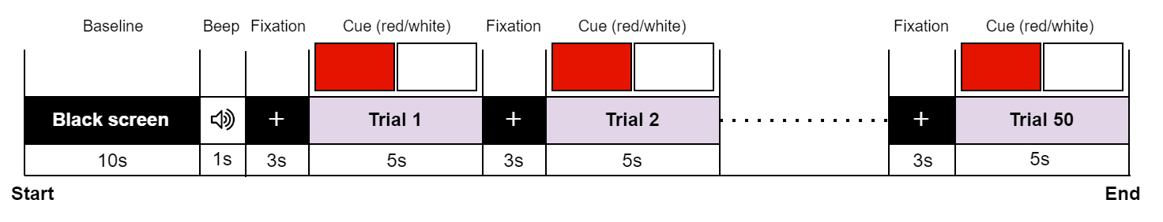
2. Plan of when and for how much duration to show red or white color:
In each session recording:
total time: 340 sec (5.66 min)
50 colors shown

Slide 5
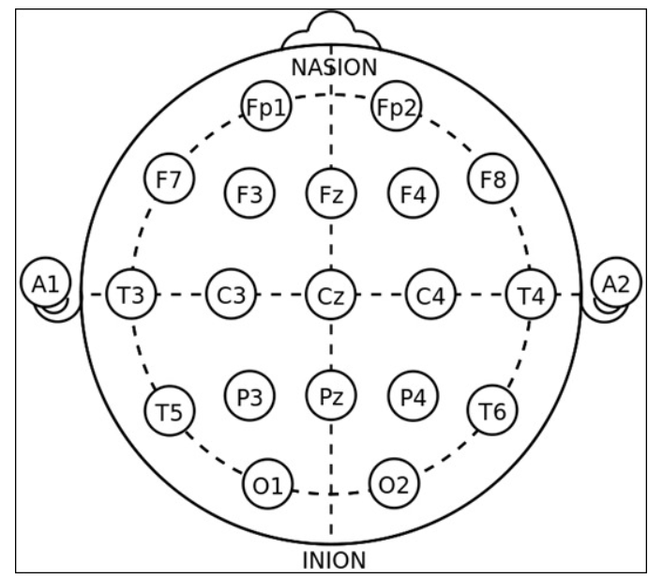
3. Step by step process we used OpenBCI to collect the brain signals data.
3.1 Setting the hardware part
1.) decide which which portion of the subject’s head you want to measure the data from by setting the points on the headset. We are using fp1,fp2,c3,c4,p3,p4,o1,o2 as visual stimuli is measured by the back of the head and using ………………….. as support electrodes.
2.)make the subject wear this headset kit and make it comfortable on the subject’s head by adjust the supporting and non-supporting electrodes(which actually gives us data) to get the brain signals as a data properly.
3.) put the SRB pin clip to the right ear to get all be measured against this reference pin.
4.) connect dongle to the PC

Slide 6
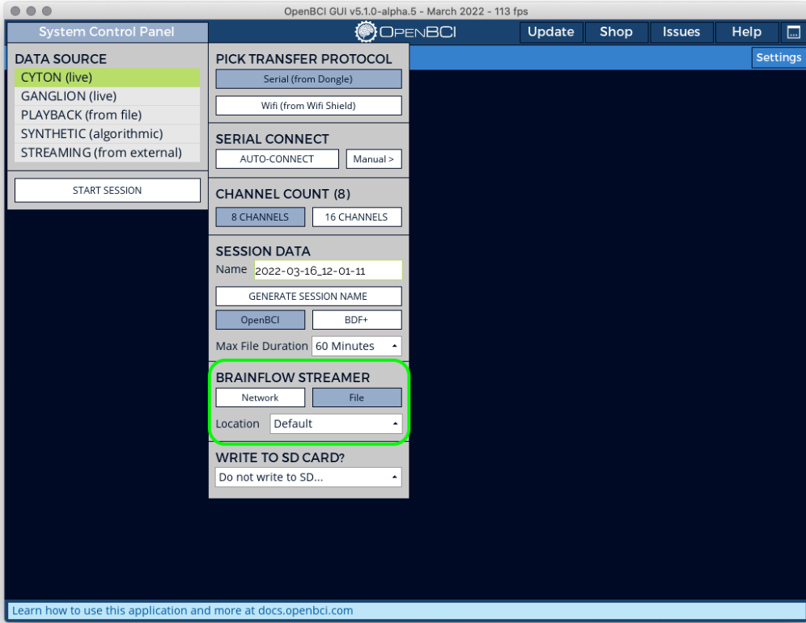
3.2 Setting the software part
1.) installing Softwares - a) OpenBCI GUI b) driver for support < windows 11
2.) Open the openBCI GUI. Click on system control panel -> CYTON(live) ->Serial from Dongle . and then click on SERIAL CONNECT->AUTO-CONNECT. to get the data from the electrodes in headset into the PC through the Dongle.

Slide 7
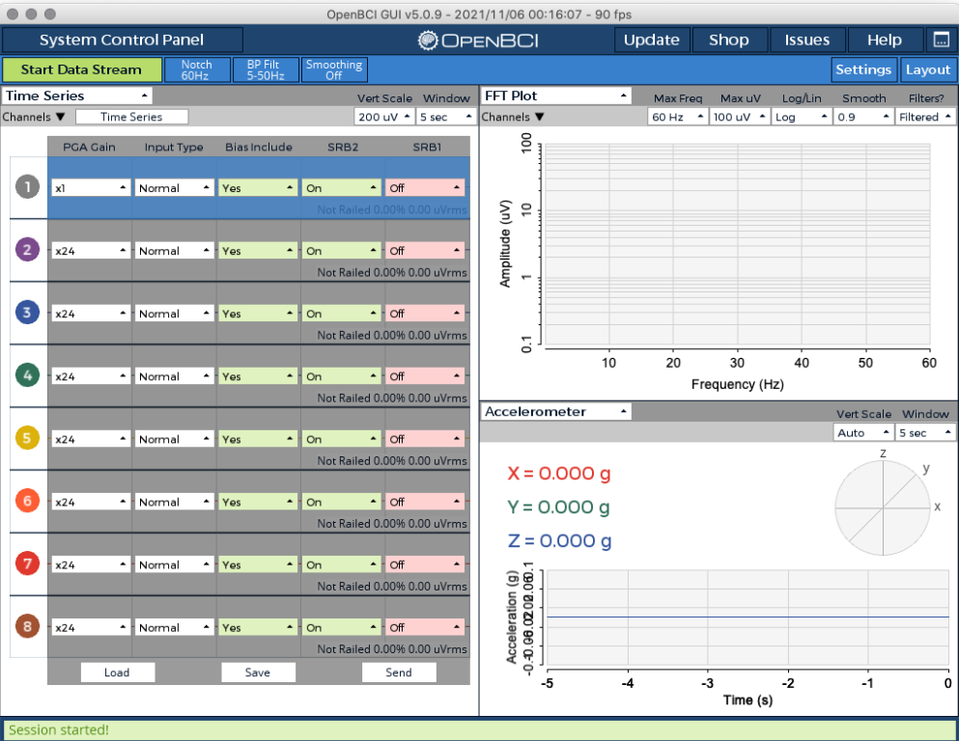
3.) Now session is started, completing the hardware settings:-
set the PGA gain= 4 (…why…) and bias include = No (….why…) for all the 8 channels.

Slide 8
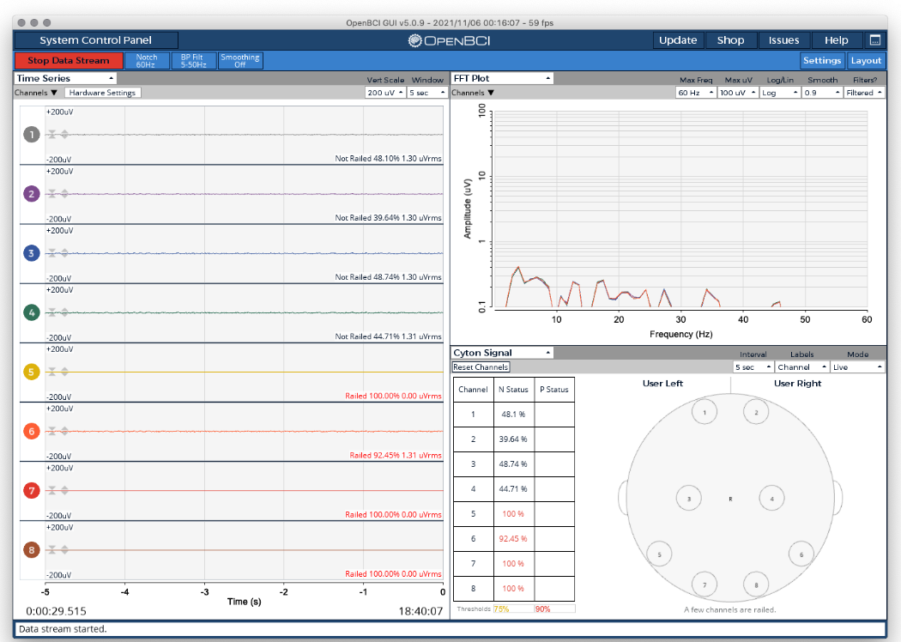
4.) Now for checking the signal quality :-
Go to the FFT plot and try to put not railed for all the channels for good quality of signal. Now we are ready to collect the signals.
5.) for stop collecting the data click on stop data stream . Data for this session will get saved as .txt and .csv format and events.txt file also got saved using the python script we wrote.

Slide 9
4. Data Description
Subject_2
Subject_1
Session_1
Session_2
Session_3
Session_1
Session_2
Session_3
Each session has:
events.txt – stores the time stamp information of red and white data in trial.txt.
trials.txt – contains brain signals data of all the 8 channels and their time stamps using OpenBCI.
We filter out the data of only (all the 8 channels and the time stamp) from trials.txt.

Slide 10
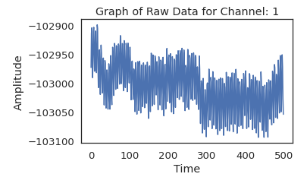
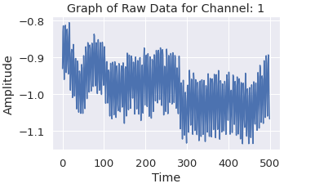
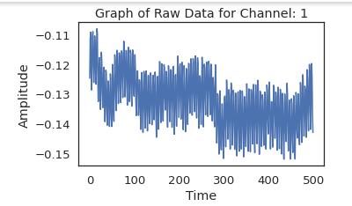
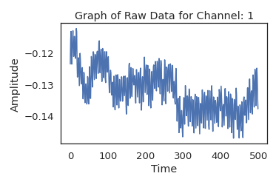
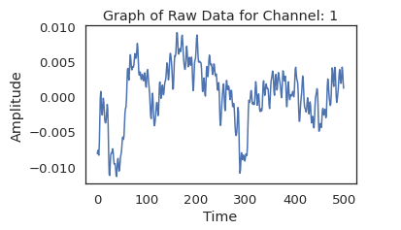
5. Data preprocessing:
Raw data 🡪 common average referencing 🡪scaling factor🡪 50 hz notch filter 🡪 0-40 hz band pass filter
Raw data
After common average ref
After Notch filter
Scaling factor
After Band pass filter

Slide 11
6. Data Epoching:
By filtering out only the time stamps when the red or white color was shown.
(50colors)
Also each second 256 readings were recorded, by splitting the data secondwise and removing the last 5 readings from each of the seconds
Further splitting the each of the 50 colours(which are of 5 sec each) into 5 readings.
So we are getting (250,250,8) matrix for each session
Each session
No. of trials in each second
No. of channels
Then we concatenated all the 3 sessions readings of subject_1 concatenated all and 3 sessions readings of subject_2 together
Then we got (1500,250,8) matrix for each of the subject_1 and subject_2

Slide 12
7. Feature Extraction
Then the features we extracted from this kind of organized data-
Statistical Features (mean, standard deviation, skewness, kurtosis)
2. DCT Features (dct power)
3. Wavelet Features (cA energy, cD energy)
4. Band Power (delta, theta, alpha, beta, gamma)
5.) PCA (Principal Component Analysis) features
6.) CSP (common spatial pattern) features using scratch code
7.) CSP (common spatial pattern) features using built in library mne

Slide 13
8. Feature selection:
Experimented on different feature combinations we extracted
1. only statistical features:
15. Statistic + DCT + Wavelet + Band Power:
2. Only with DCT features:
16. Only PCA features
3. Only with Wavelet features:
4. Only with Band Power:
17. Only CSP features using using scratch code
5. Statistic and DCT:
18. Only CSP features using mne library
6. Statistic and Wavelet:
7. Statistic and band Power:
8. DCT and Wavelet:
9. DCT and Band Power:
10. Wavelet and Band Power:
11. Statistic + DCT + Wavelet:
12. Statistic + DCT + Band Power:
13. Statistic + Wavelet + Band Power:
14. DCT + Wavelet + Band Power:

Slide 14
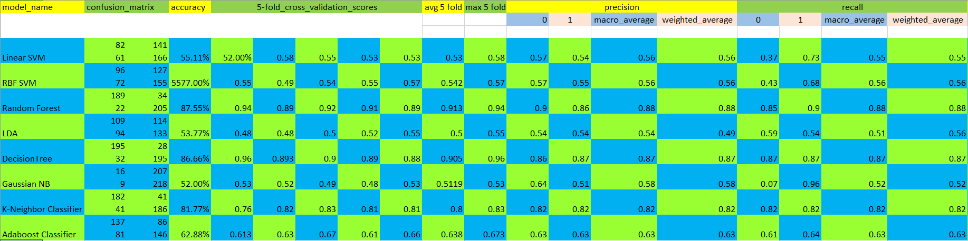
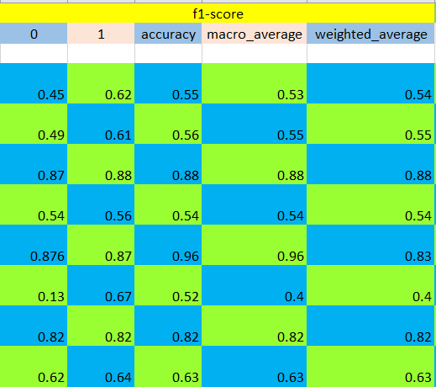
10. Results
1. only statistical features:

Slide 15
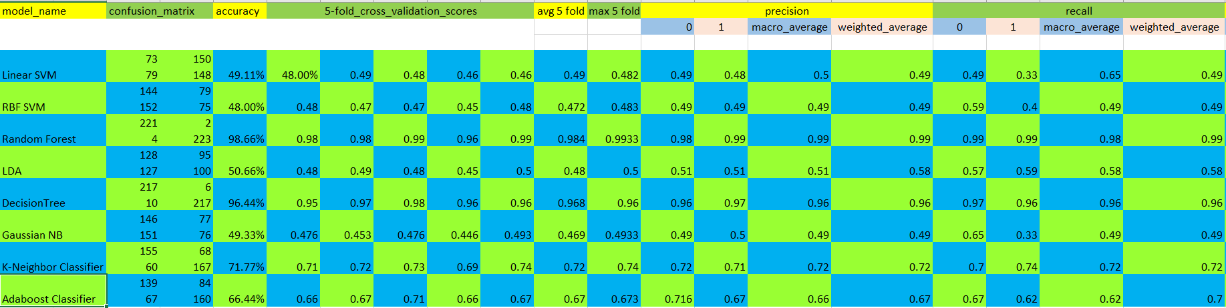
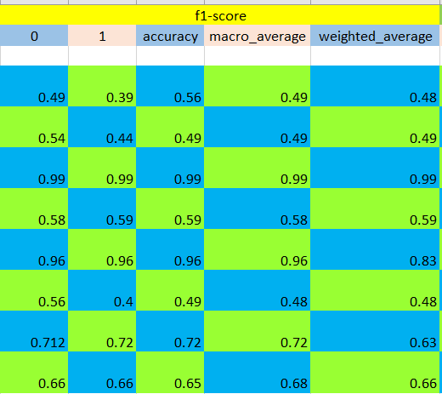
2. Only with DCT features:

Slide 16
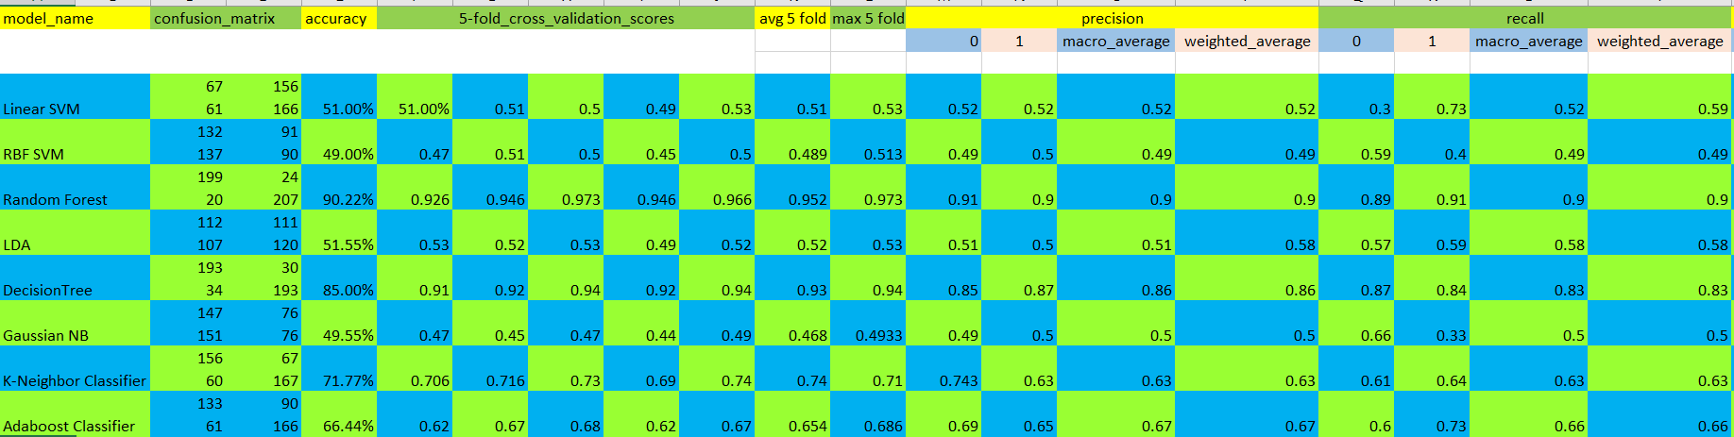
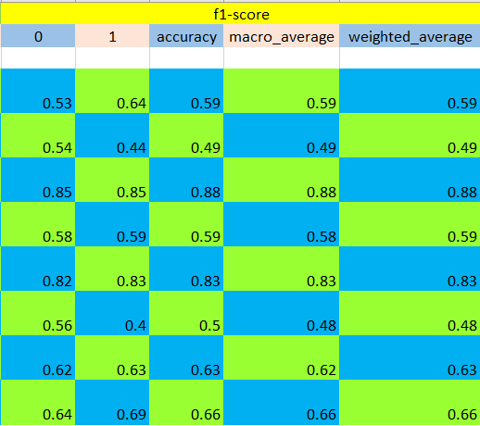
3. Only with Wavelet features:

Slide 17
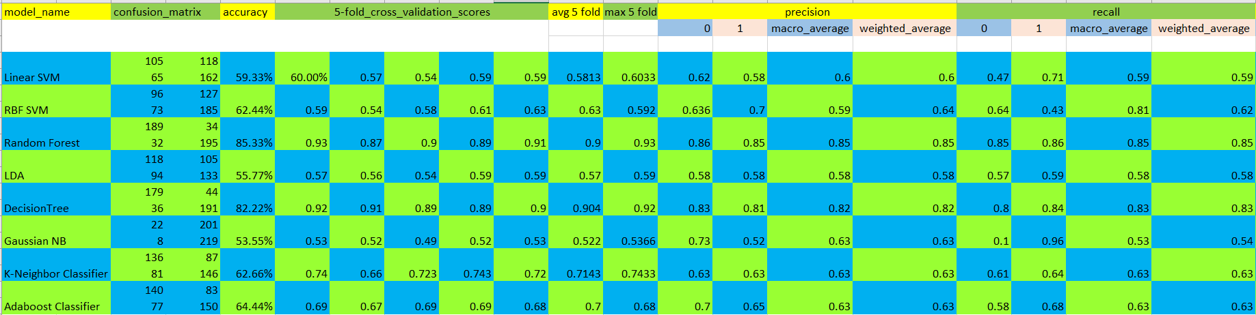
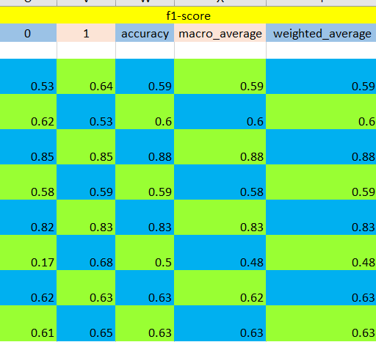
4. Only with Band Power:

Slide 18
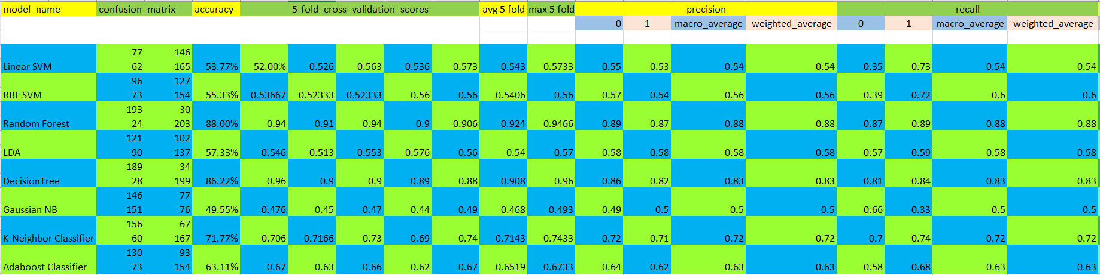
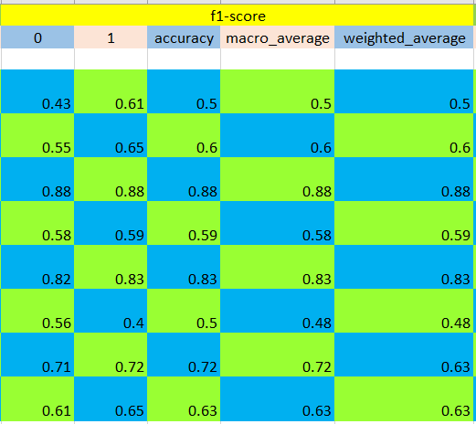
5. Statistic and DCT:

Slide 19
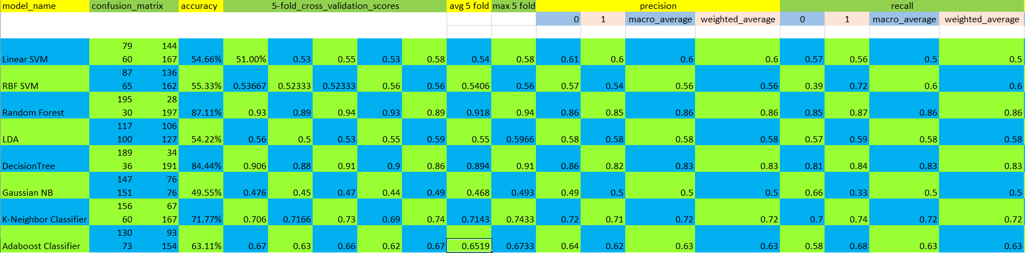
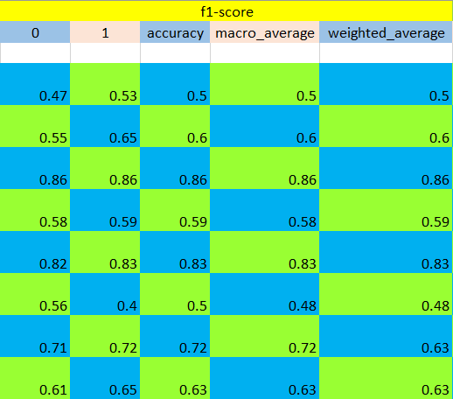
6. Statistic and Wavelet:

Slide 20
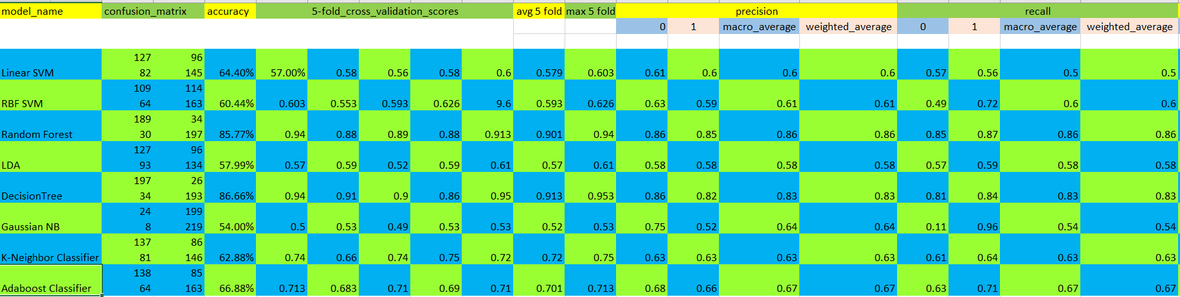
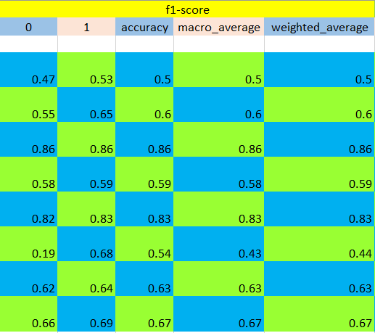
7. Statistic and band Power:

Slide 21
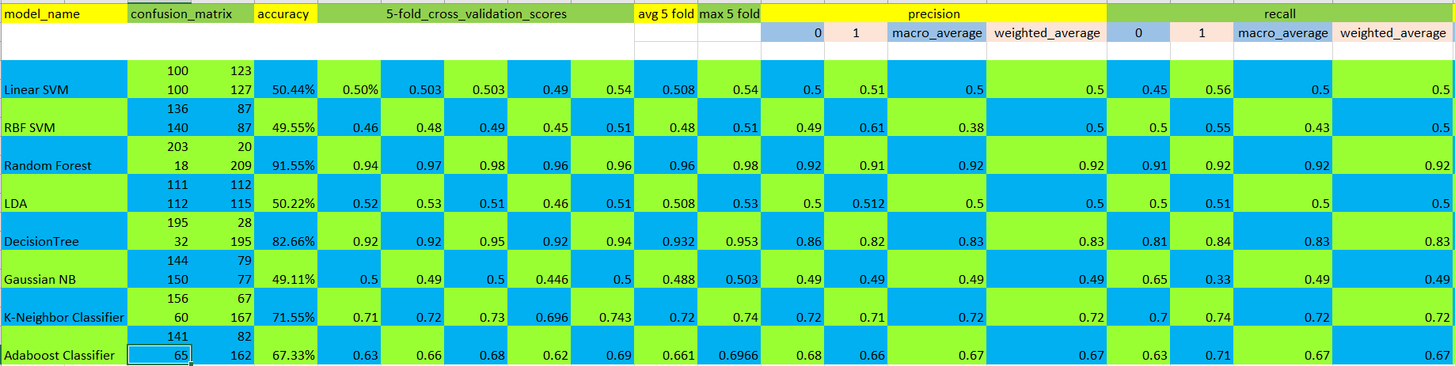
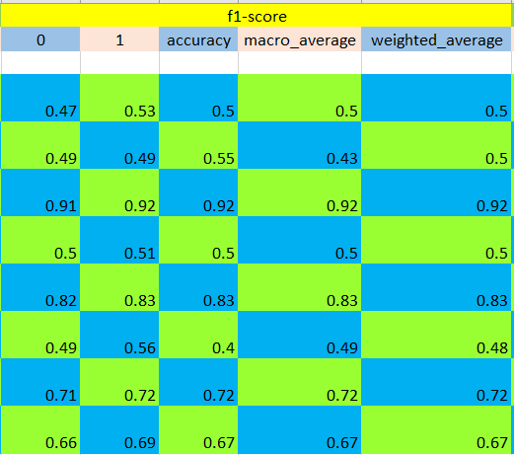
8. DCT and Wavelet:

Slide 22
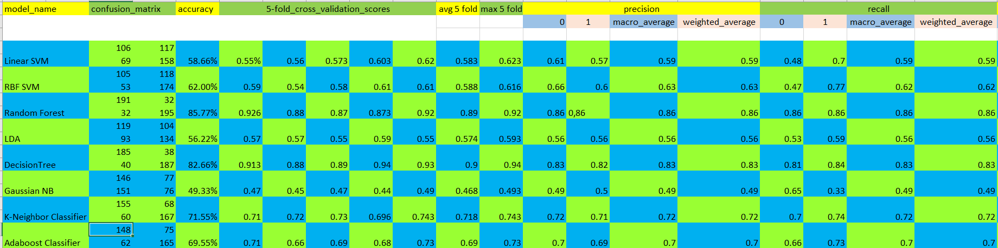
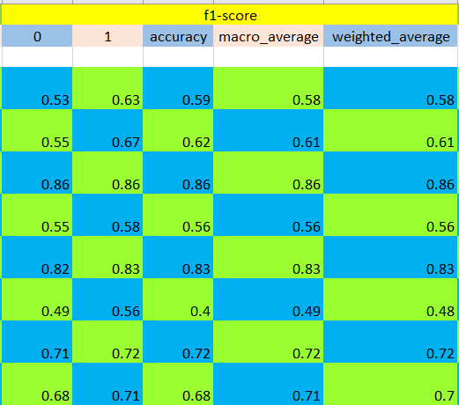
9. DCT and Band Power:

Slide 23
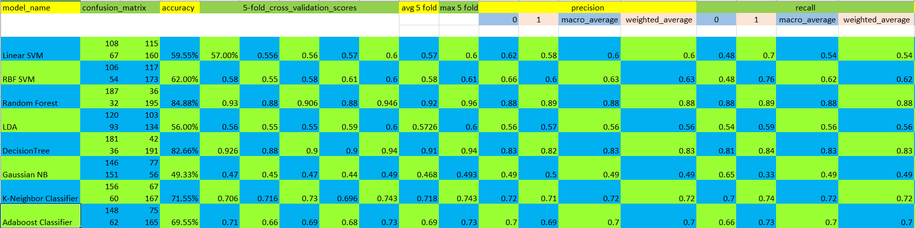
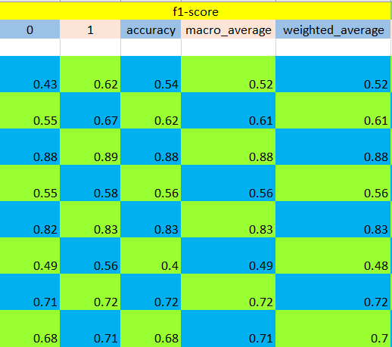
10. Wavelet and Band Power:

Slide 24
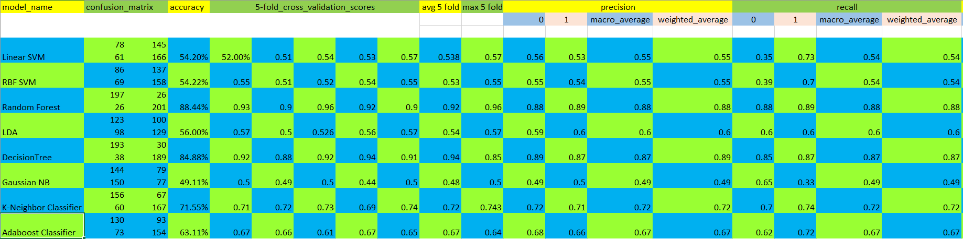
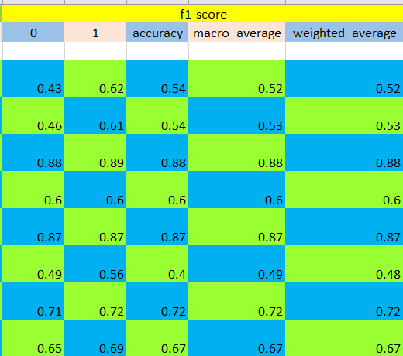
11. Statistic + DCT + Wavelet:

Slide 25
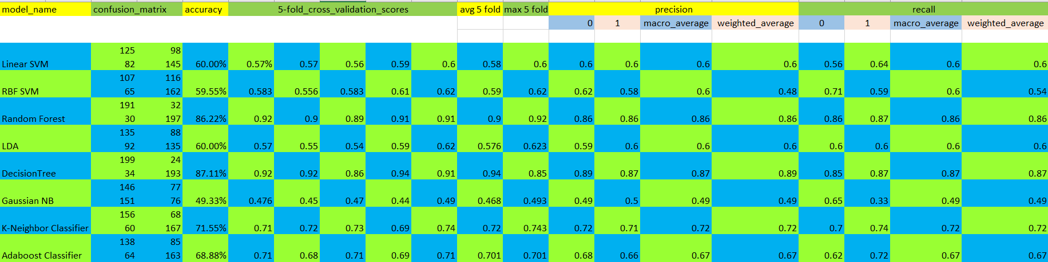
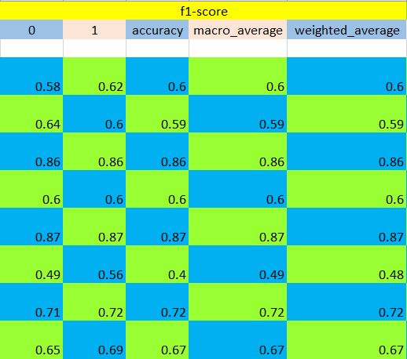
12. Statistic + DCT + Band Power:

Slide 26
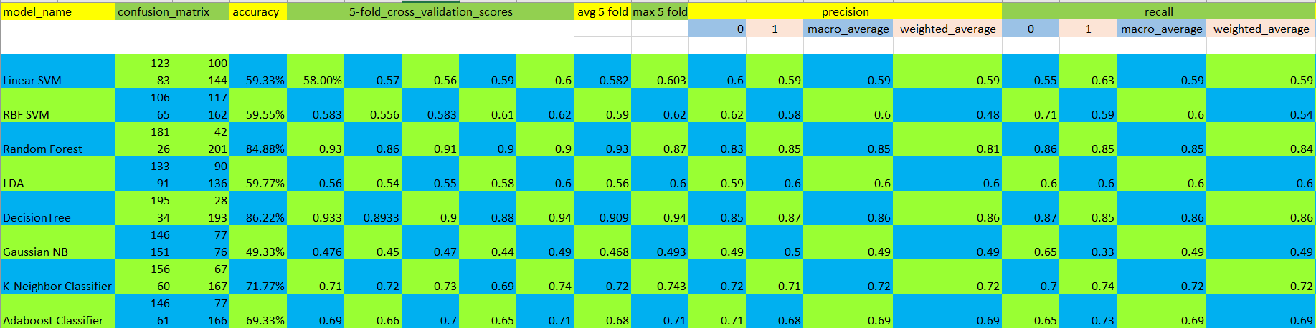
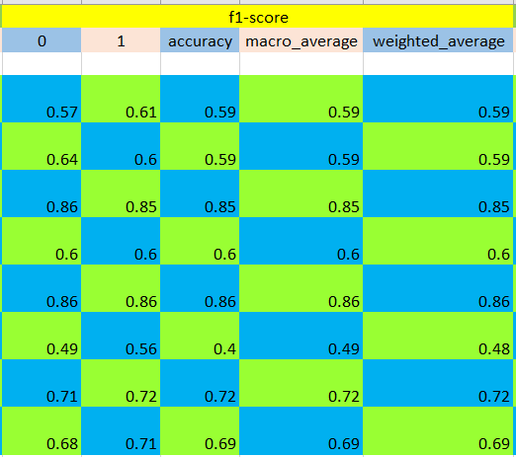
13. Statistic + Wavelet + Band Power:

Slide 27
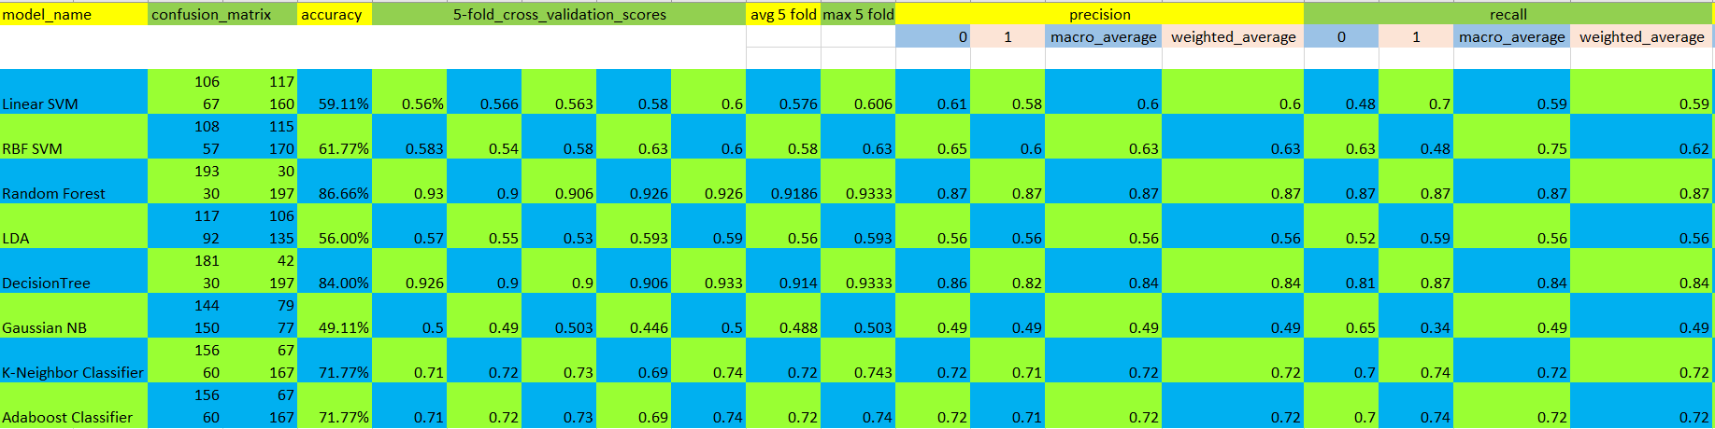
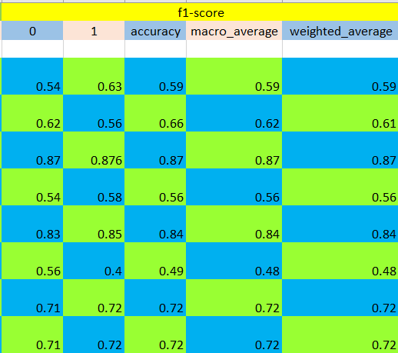
14. DCT + Wavelet + Band Power:

Slide 28
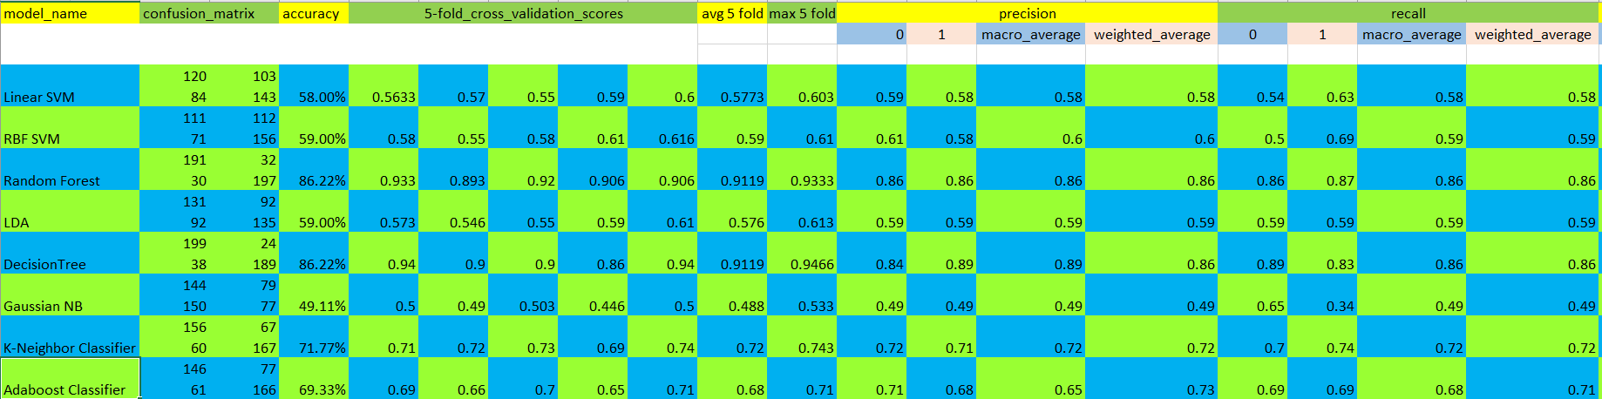

15. Statistic + DCT + Wavelet + Band Power:

Slide 29
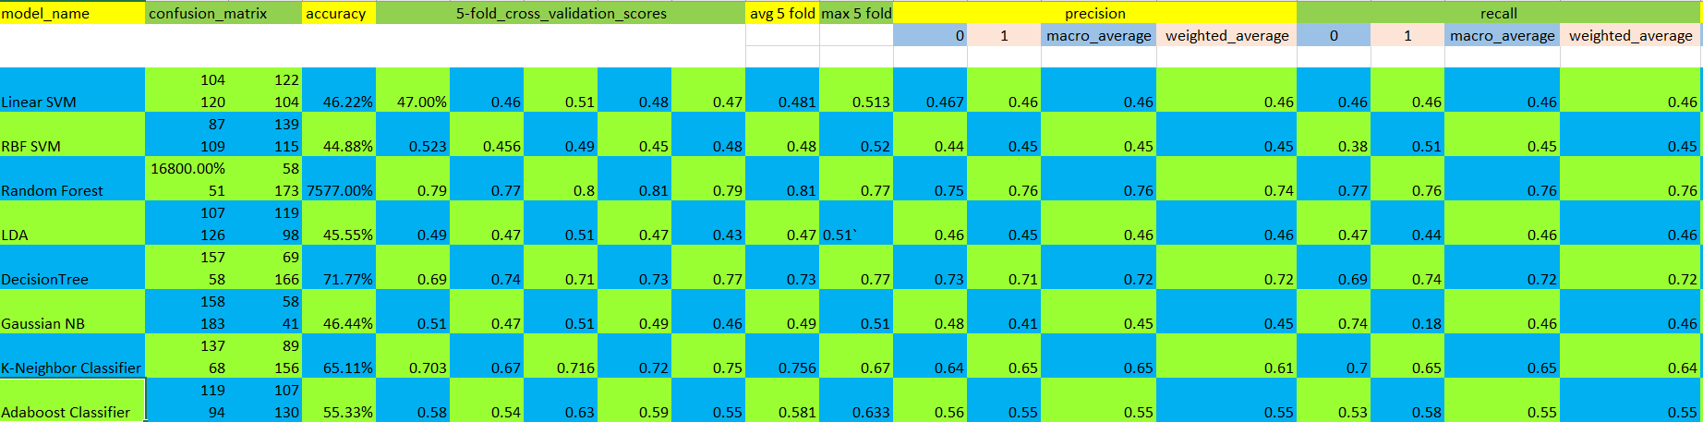

16. Only CSP features using using scratch code

Slide 30

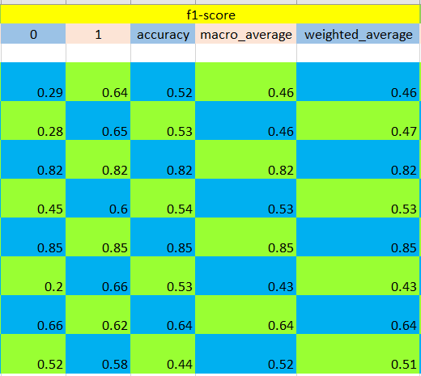
17. Only PCA features

Slide 31

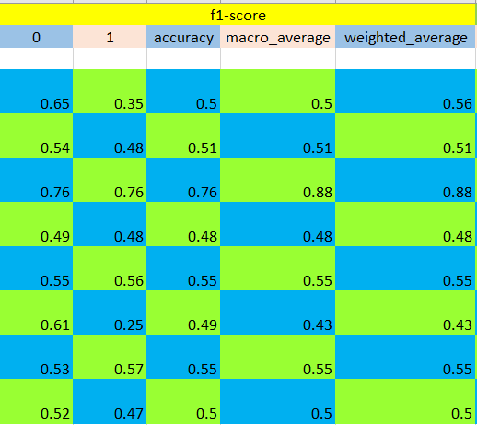
18. Only CSP features using mne library

Slide 32
11. conclusion
Model:
mostly random forest and decision tree is giving us very good accuracy.
Features:
only with DCT features are giving very good accuracy.

Slide 33
THANK YOU

